Slide 1

AscentPay: Elevate Your Finances
Welcome to AscentPay, your new digital banking solution.
Sandhya koukuntla-700769703

Slide 2
Contents
Introduction
Technologies Used
System Overview
Features Implemented
Database Design
User Roles
Security Measures
Challenges Faced
Development Methodologies
Future Enhancements
Conclusion

Slide 3

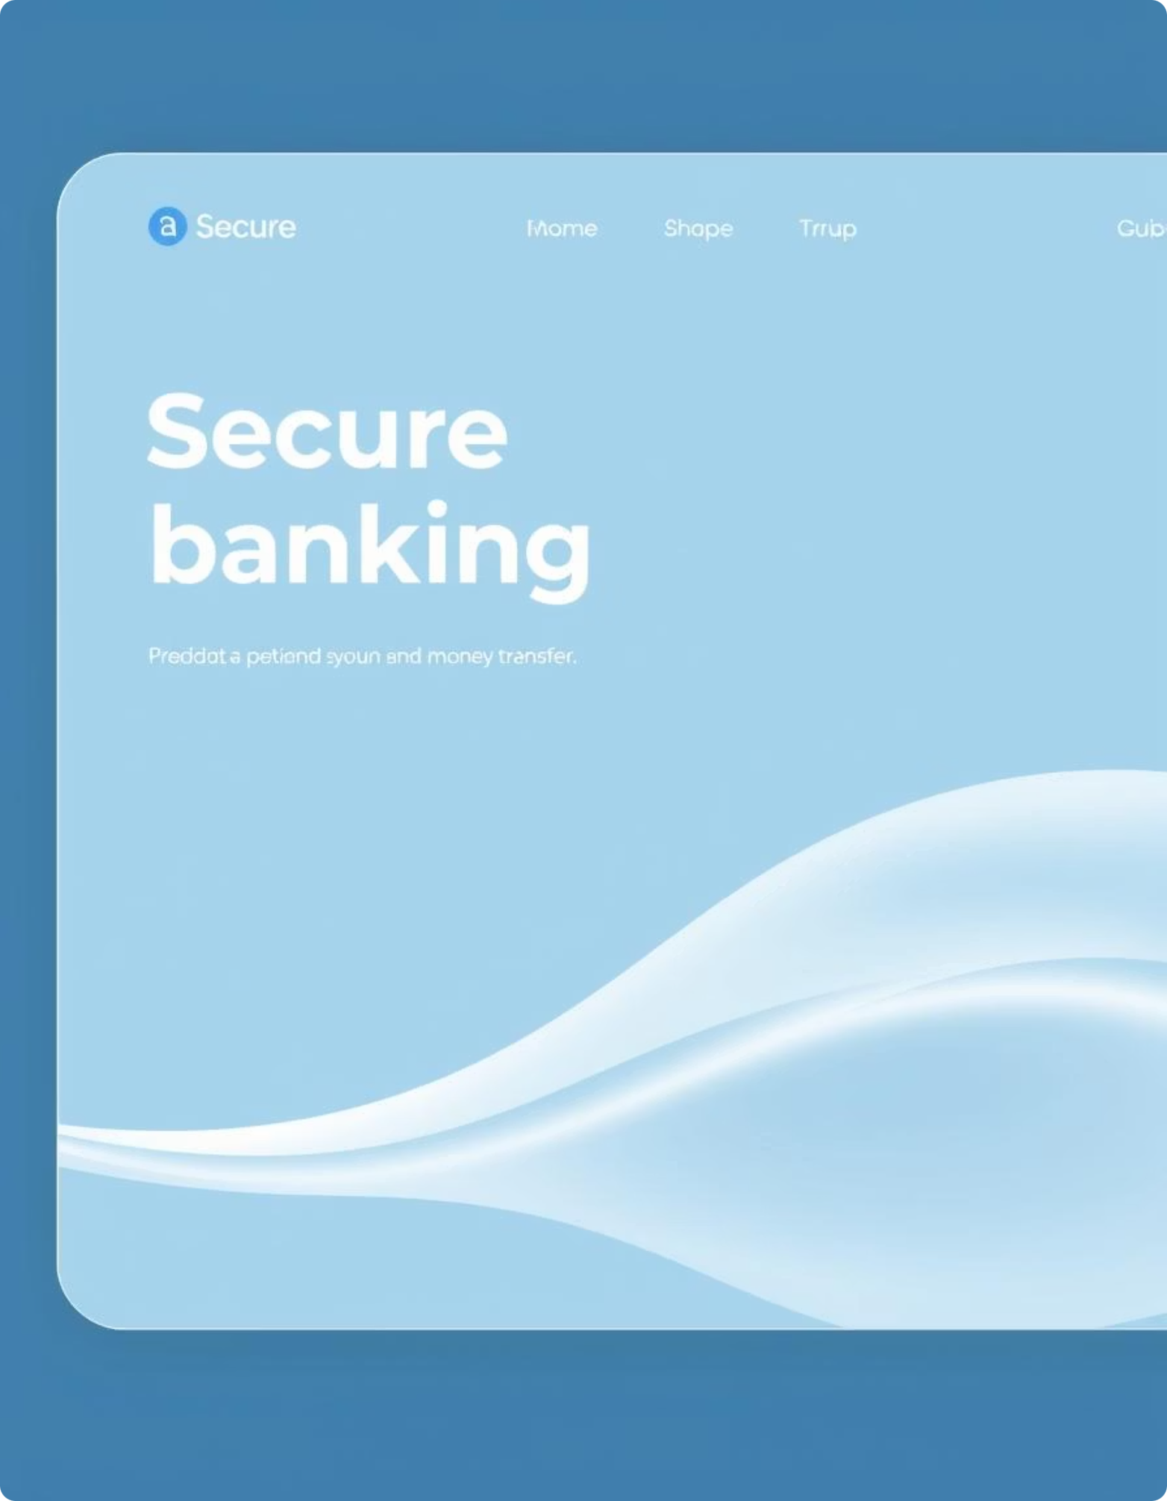
Introduction
The Digital Banking Application offers a modern solution for online banking by implementing the following key features:
• User Management: Registration, authentication, and role-based access for customers and administrators.
• Transaction Management: Enabling users to perform deposits,
withdrawals, transfers, and view detailed transaction history.
• Admin Monitoring: Allowing administrators to manage user accounts,
monitor transactions, approve new accounts, and maintain the security of the platform.

Slide 4





Technologies Used
Python (Flask)
MongoDB
HTML, CSS
Backend web framework for robust application logic.
NoSQL database for flexible and scalable data storage.
Frontend templates for user interface development.
bcrypt
Flask-Session
Password hashing for enhanced user security.
Secure session management for user authentication.

Slide 5

System Overview
Multi-role System
Admin, Bank Officer, Customer access levels.
Core Banking Functions
Account management, deposits, fund transfers.
User Approvals
Admin-controlled new customer onboarding.
Ecommerce Simulation
Integrated purchase functionality.
Debit Card Processing
Simulated transaction handling.

Slide 6

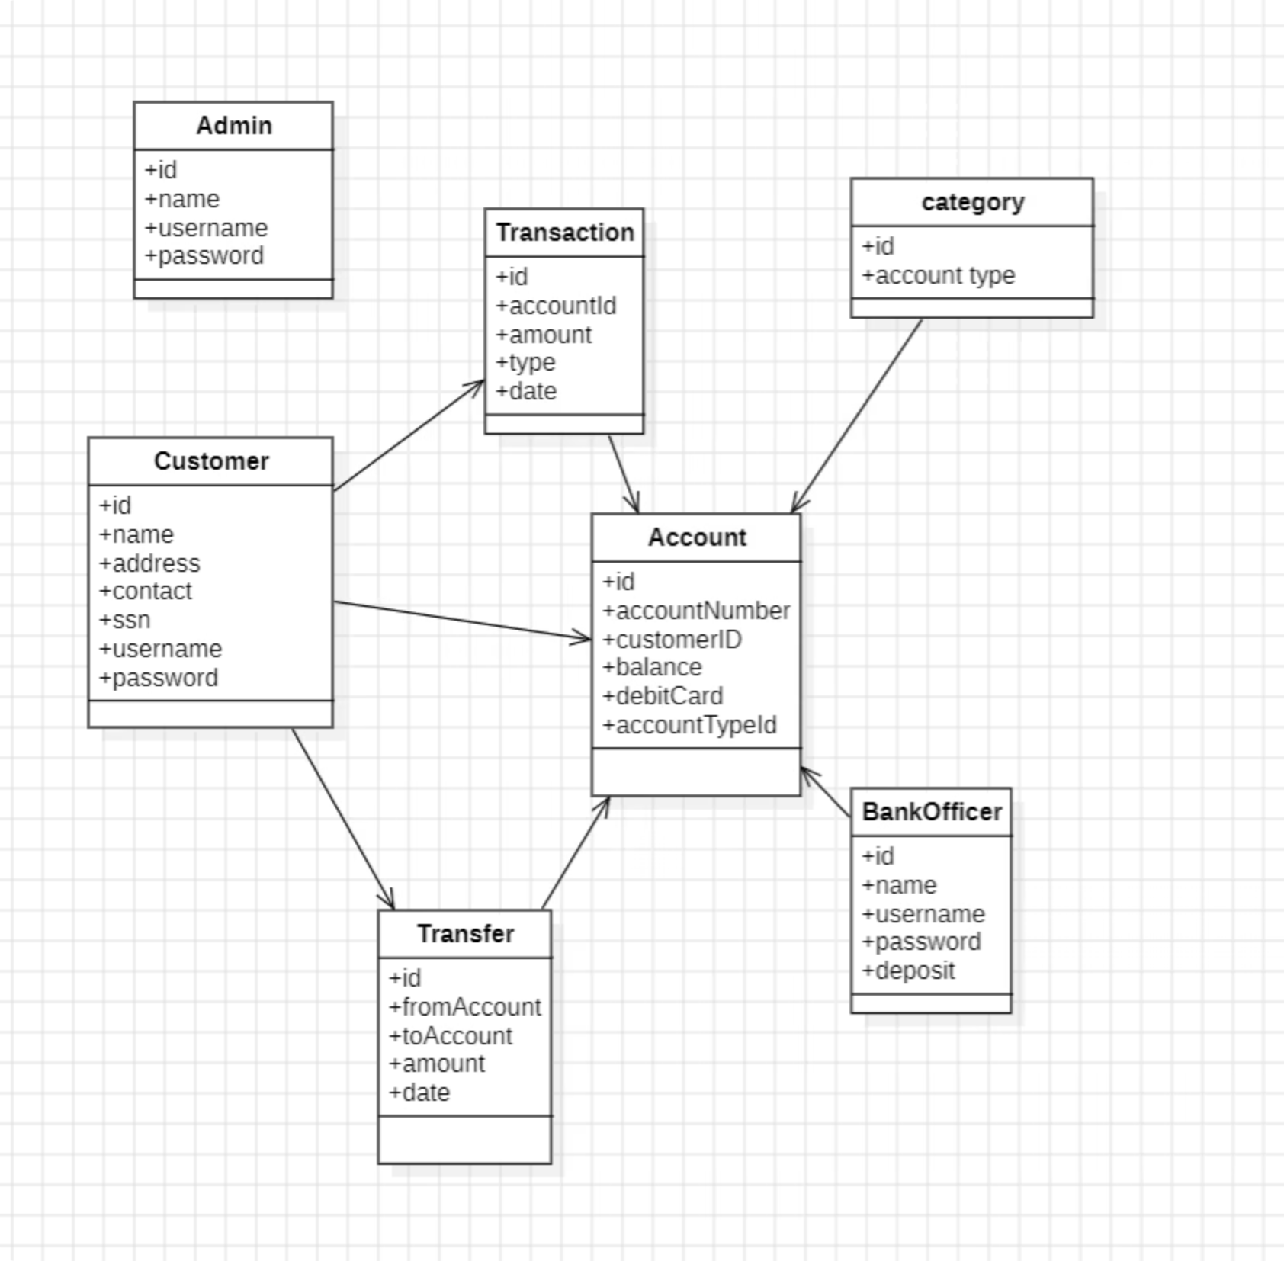
System Architecture Diagram
This diagram illustrates the logical architecture of the digital banking application, showcasing the interconnected components and data flow between the user interface, Flask backend, and MongoDB database.

Slide 7


Features Implemented
Secure User Management
Registration, login, hashed passwords.
Admin Oversight
Approval of new customer accounts.
Account Provisioning
Debit card details linked to accounts.
Financial Transactions
Deposits and secure fund transfers.
Comprehensive History
Detailed transaction tracking for users.
Overdraft Management
Automated handling and fee enforcement.

Slide 8







Database Design (MongoDB Collections)
Customers
Admin
Stores customer profiles and details.
Manages system administrators' data.
Bank Officer
Accounts
Holds bank staff information.
Contains account balances and debit card info.
Transactions
Banks
Records all financial movements.
Stores bank-specific configurations.

Slide 9





User Roles
Admin Role
Approves new users, manages bank officers, oversees transactions.
Bank Officer Role
Performs deposits, handles user account management.
Customer Role
Views balance, transfers funds, purchases with debit card.

Slide 10





Security Measures
bcrypt Hashing
Strong password protection against breaches.
Session Authentication
Secure user sessions, preventing unauthorized access.
Input Validation
Prevents injection attacks and data corruption.
Financial Controls
Overdraft limits and fee enforcement for integrity.

Slide 11



Future Enhancements
Enhanced Overdraft Logic
Unified Session Handling
Implement more sophisticated logic for overdraft management, including dynamic fee application and automated notifications to users.
Improve session consistency and security across all user roles (Customer, Bank Officer, Admin) for a smoother, more reliable experience.
Optimized Database Architecture
Mobile Banking Platform
Refine and normalize MongoDB schema design for improved data integrity, scalability, and overall system performance.
Develop a user-friendly mobile application for customers to securely access and manage their banking services on the go.

Slide 12


Conclusion
Secure & Reliable
Streamlined Finances
Future-Ready Foundation
AscentPay stands as a robust platform, prioritizing user data and financial security through strong hashing, session authentication, and rigorous input validation.
With intuitive features like easy fund transfers, comprehensive transaction history, and automated overdraft management, AscentPay simplifies daily financial operations for users.
Built on a scalable MongoDB architecture and designed with clear user roles, AscentPay is primed for future enhancements and continuous innovation in digital banking.

